Slide 1
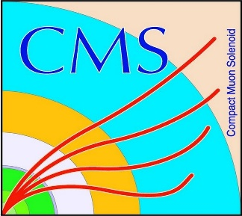

HEP Weekly Report
George Bakas
NTUA

Slide 2
Progress Report
DCS
Trying to configure/understand the DIM/DIP communications
DIM = Distributed Information Management
DIP = Data Interchange Protocol based on DIM
Analysis
Trigger or help with the 2016 data paper
ArdEnvino
Assemble tools that are needed for the prototype board
Meeting with Florian on Tuesday to check the final consistency of the new PCB

